Slide 1
Astro 331 Lesson 1
Introduction to Space
Systems Engineering
Supp Crs Mtl

Slide 2
Lesson Objectives
Describe the desired goal of space mission design
Explain common elements shared in good definitions of systems engineering
Describe the systems engineering V-model
Explain why it is important to exercise good systems engineering early in a program

Slide 3
Desired Goal of Space Mission Design
Want to generate a design that:
Considers all aspects of the space mission
Spacecraft, launch, operations, ground segment, user needs
Meets mission requirements
At an acceptable cost
At an acceptable level of risk
We will delve into each of these topics in greater detail in this course

Slide 4
Common Threads of Good SE Definitions
Top-down approach
Life-cycle orientation
Definition of system requirements
Interdisciplinary

Slide 5
Definition of Systems Engineering
An interdisciplinary approach and means to enable the realization of successful systems. It focuses on defining customer needs and required functionality early in the development cycle, documenting requirements, then proceeding with design synthesis and system validation while considering the complete problem: operations, performance, test, manufacturing, cost & schedule, training & support, and disposal. Systems Engineering integrates all the disciplines and specialty groups into a team effort forming a structured development process that proceeds from concept to production to operation. Systems Engineering considers both the business and the technical needs of all customers with the goal of providing a quality product that meets the user needs.
top-down
International Council on Systems Engineering (INCOSE), 7670 Opportunity Road, Suite 220, San Diego, CA, USA.
life-cycle
defn sys rqmts
interdisciplinary

Slide 6
V-model
Testing
V
Define System Requirements
Full System Operation and Verification
Allocate System Functions to Subsystems
Verification of Subsystems
Decomposition and Definition
Integration and Verification
Detail Design of Components
Verify Components
Notes:
Forsberg and Mooz developed
Decomposition on the left down to an architecture, verification and testing up the right side to meet the original customer needs
At all levels the original needs and requirements are verified

Slide 7
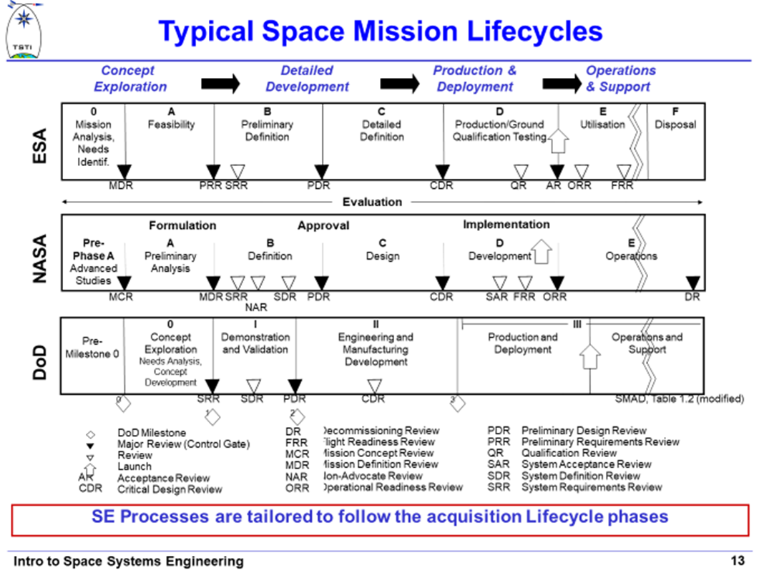

Slide 8
Develop Concept
Design & Develop System
Produce System
Deploy System
Operate System
Retire System
Need
Conceptual Design
Preliminary Design
&
Detail
Design

Slide 9
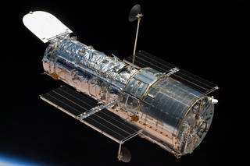
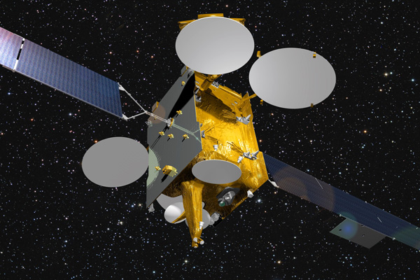
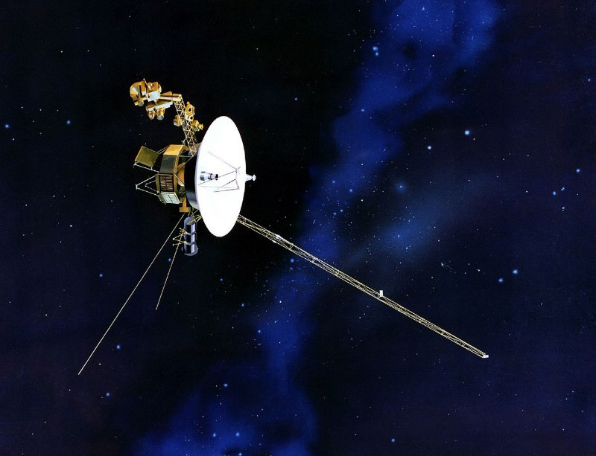

Slide 10
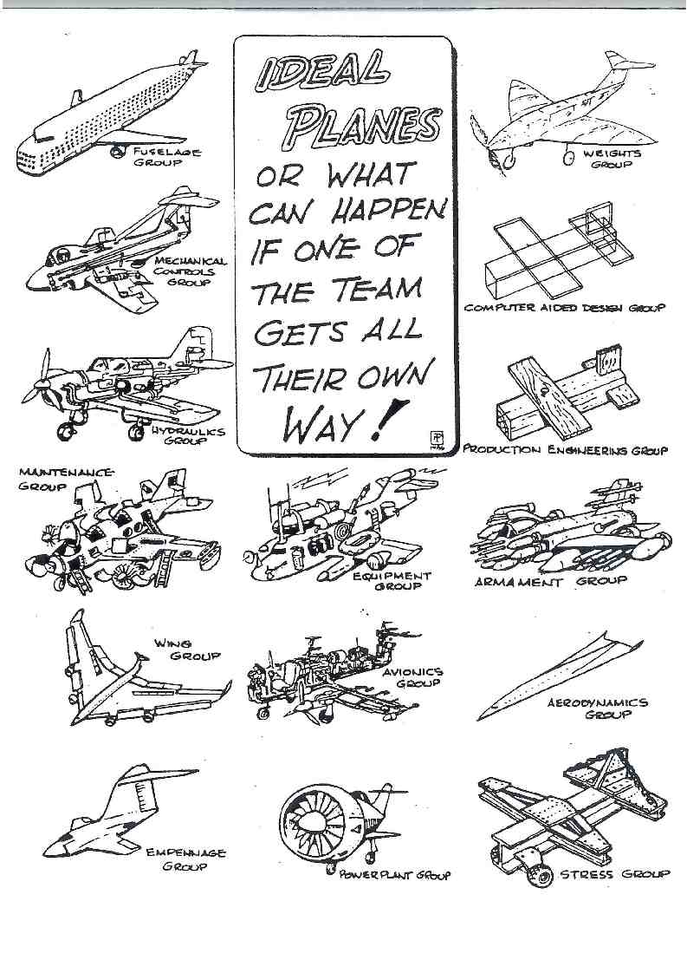
“Best” Designs If Each Team Gets Their Way
Systems engineering is a holistic approach that considers what design choices are best for the system as a whole, not just one segment.
Notes:
The best SYSTEM is the sum of the best SUBSYSTEMS
Compromises must be made in each subsystem to optimize the overall system.

Slide 11
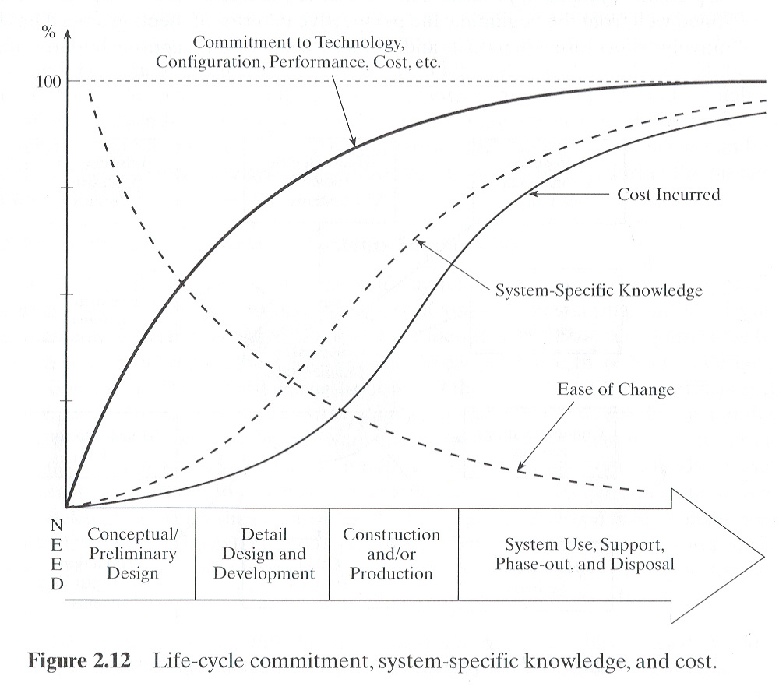
Life Cycle Commitment, System Specific Knowledge, & Costs

Slide 12
Life Cycle Commitment, System Specific Knowledge, & Costs
Commitment to an approach builds rapidly
Significant life cycle cost is incurred late
Knowledge of the system lags behind commitment to approach
Change is easiest early in lifecycle
So, what do you conclude?

